Slide 1
Controlling the Uncontrollable

Slide 2
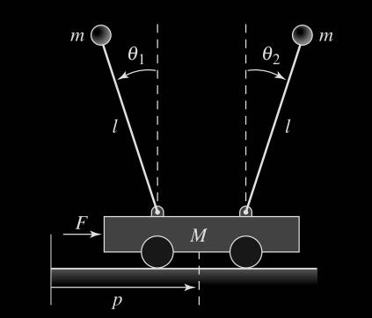
Setup

Slide 3

Dynamics

Slide 4
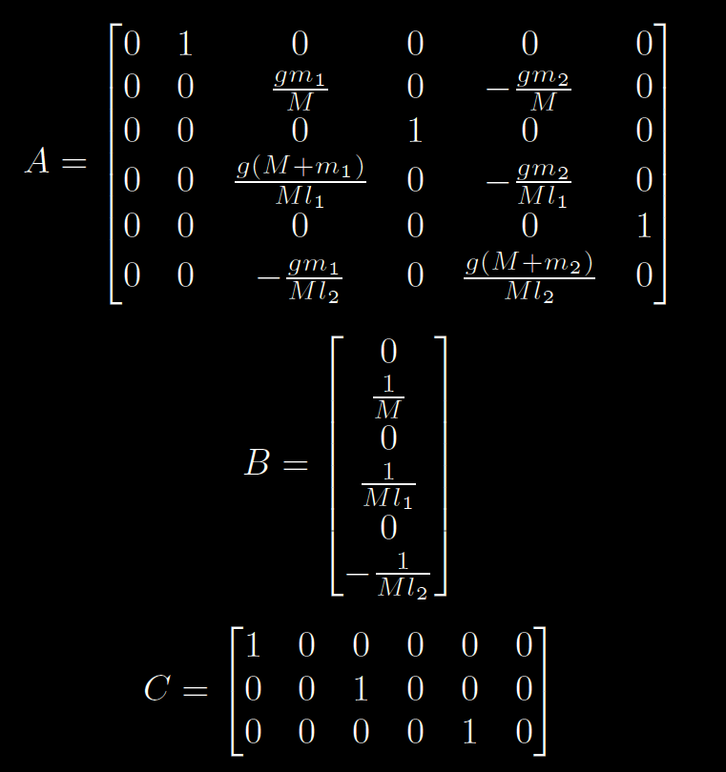
States

Slide 5
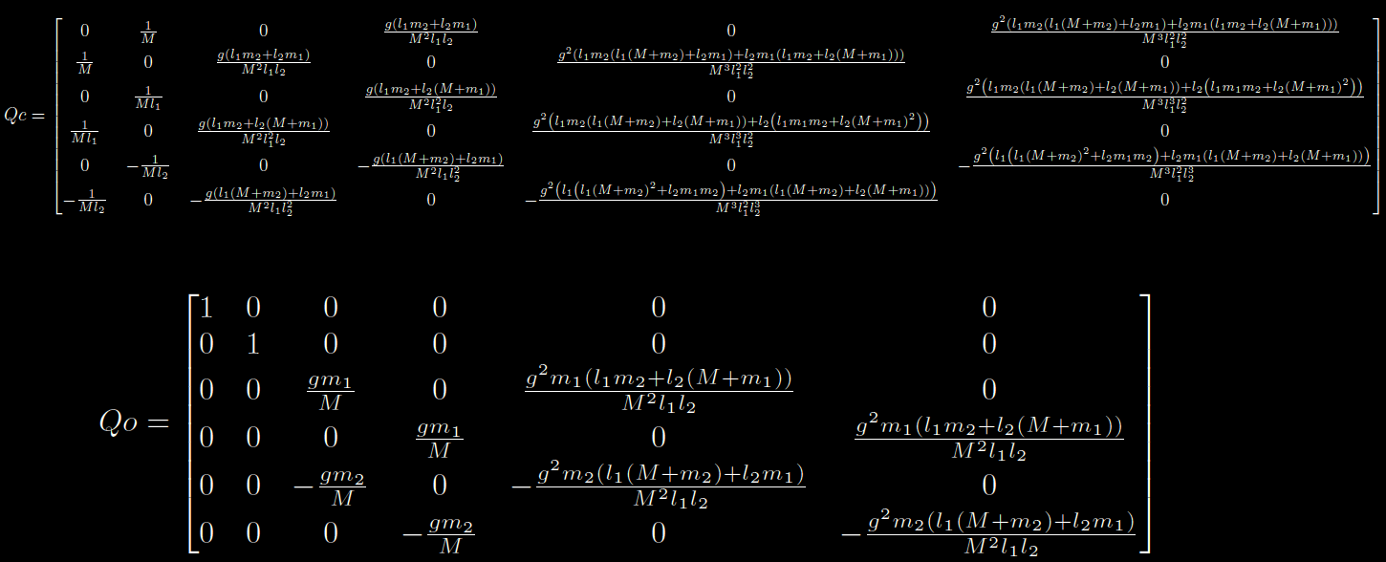
Controllability and Observability

Slide 6
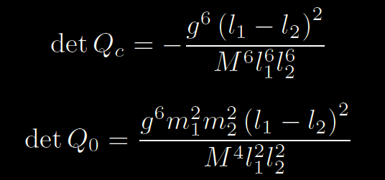
Controllability and Observability

Slide 7
Designing a controller
Full state feedback, LQR
Heavy weighting on the states

Slide 8
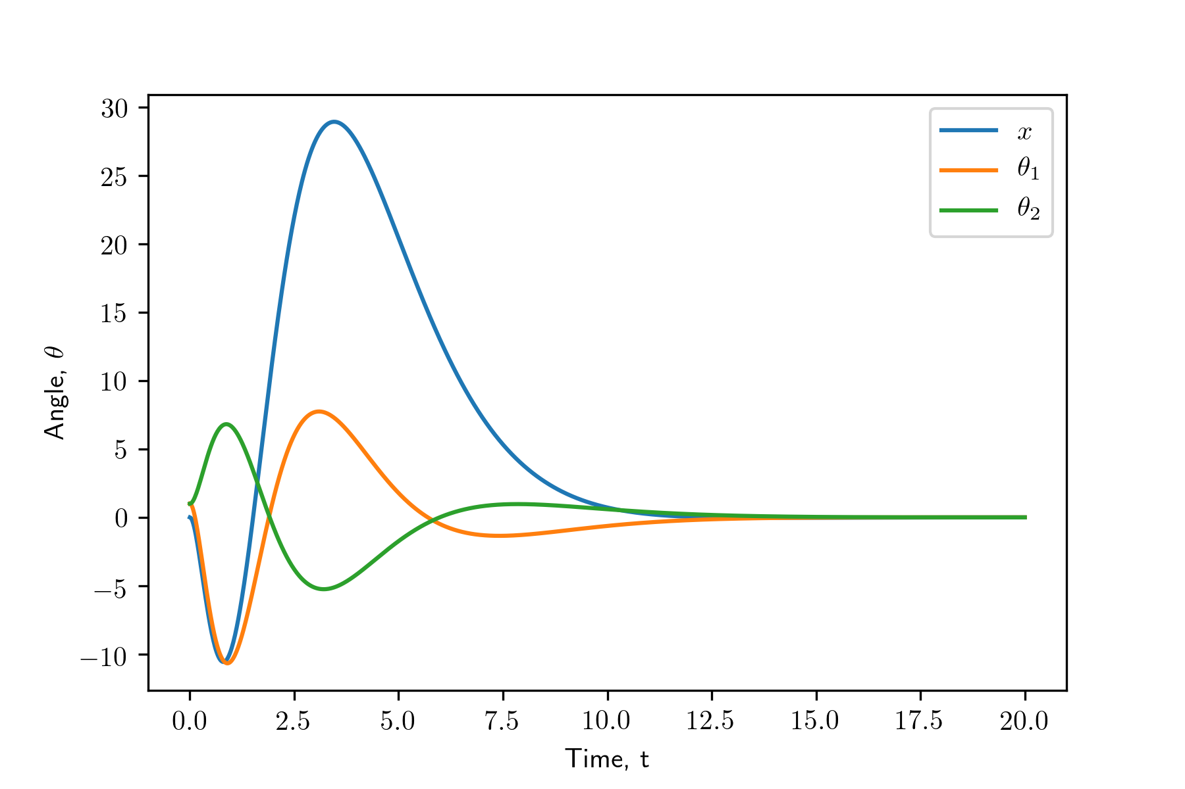
Impulse Response

